Slide 1
The Persuasive Essay
Notes:
This is the first BIG unit of this course. You will be reading many essays and eventually writing your own. This is a big deal considering the fact that this is UNIVERSITY ENGLISH and presumably you will all be writing essays for professors next year. In the heyday of my university career I was writing upwards of 30 essays a year. You have got a year to go before you are thrown into that world and this is the course in which you receive the most detailed essay preparation. Therefore this unit is, not only the FIRST BIG UNIT but, the most IMPORTANT unit. But never fear, with your attention and hard work, you can master it.

Slide 2

The Persuasive Essay
This lesson will give you the language you need to start analysing the effectiveness of persuasive essays.

Slide 3
The writer wishes to convince the reader to believe his/her thesis (or at least to consider its validity) through the use of STRONG argument (logic) and emotional appeal (pathos).
Notes:
First of all, what is a persuasive essay?

Slide 4
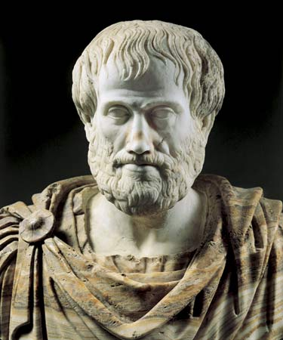
Aristotle
384 – 322 BC
RHETORIC:
The Art of
Persuasion
Notes:
Greek philosopher, a student of Plato and teacher of Alexander the Great. He wrote on many subjects, including physics, metaphysics, poetry, theatre, music, logic, rhetoric, politics, government, ethics, biology, and zoology. For our purposes, we are going to BREIFLY look at his ideas about RHETORIC, which he defines as the ability to see what is possibly persuasive in every given case. In other words, the art of persuasion.

Slide 5
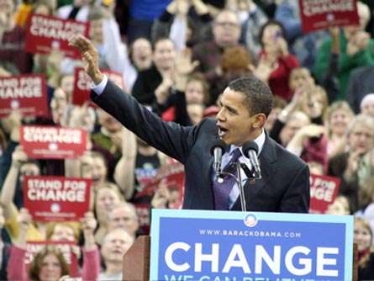
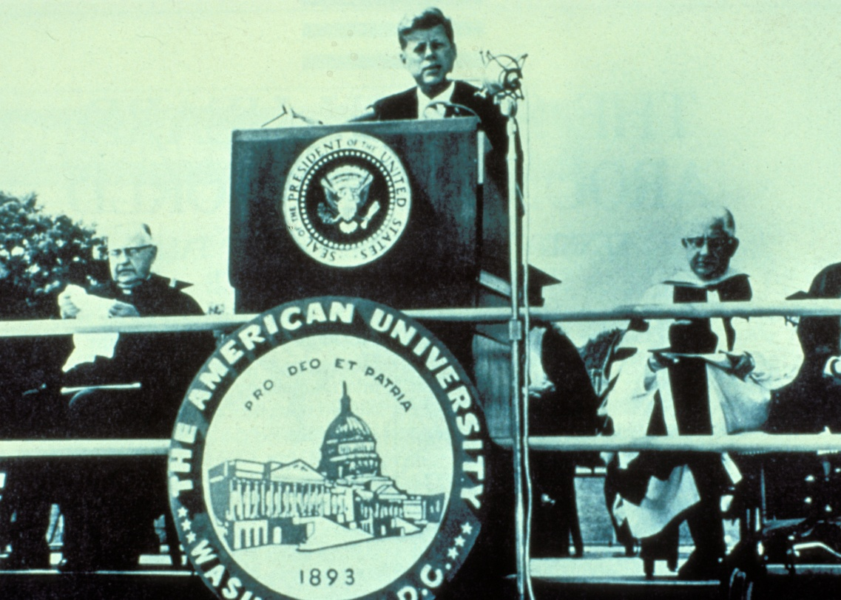
Notes:
Aristotle discussed the art of persuasion in terms of the orators of Ancient Athenian assemblies, however, his ideas are still used today and by not only great speakers, but writers as well.

Slide 6
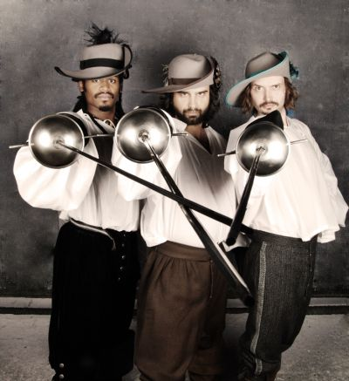
Aristotle
384 – 322 BC
RHETORIC:
The Art of
Persuasion
Ethos
Pathos
Logos
Notes:
Aristotle’s Art of Persuasion includes three elements: ethos, pathos and logos.
Not to be confused with Athos, Porthos, and Aramis, the three musketeers.

Slide 7
The Rhetorical Triangle
ETHOS
Refers to the credibility or character of the communicator, as seen by the audience or reader.
PATHOS
LOGOS
Notes:
Aristotle taught that a speaker's ability to persuade is based on how well the speaker appeals to his or her audience in three different areas: ethos (ethical appeals), pathos (emotional appeals), and logos (logical appeals). These areas form something that later rhetoricians have called the Rhetorical Triangle.
Ethos is basically credibility.
Ask yourself...

Slide 8

When considering
ethos, ask yourself...
1. “Is the author knowledgeable on the subject?”
2. “Is the author free of any vested interest or ulterior motive in the outcome of the debate?”
3. “Does the author treat opposing views with respect or take cheap shots at opponents?”
Notes:
“Is the author knowledgeable on the subject?”
For example, an aerospace engineer arguing the value of classical literature in the high school classroom carries less gravity than a university student’s argument on the same subject.
“Is the author free of any vested interest or ulterior motive in the outcome of the debate?”
A person pleading innocence of a crime or a 17 year old arguing in favour of lowering the legal age of majority in Ontario are both examples of individuals who have a vested interest in the outcome of the argument.
“Does the author treat opposing views with respect or take cheap shots at opponents?”
Consider all of those hours you have spent watching CPAC, Cable Public Affairs Channel, and during the question period you might hear one MP say to another, “My honourable opponent...” they are trying to establish ethos before they take aim at their policies.

Slide 9
The Rhetorical Triangle
ETHOS
Refers to the "emotional appeals" an authors uses to persuade their audience by arousing their emotions. Many times, this appeal is how a writer will make an argument "matter" to readers.
PATHOS
LOGOS
Notes:
If not in the hundreds of persuasive essays you all read over the summer, then you have at least experienced some pathos in advertising.

Slide 10

Notes:
For example, consider how this Save the Children uses pathos.
The ad uses a photo of a small child, so malnourished that his bones are clearly visible under his skin. He sits huddled in the open air, weak, in a foetal position. A vulture sits, waiting, in the background. The images and text in this ad are designed to have the maximum emotional effect for one thing: to motivate the reader to act — to make an act of charity

Slide 11
When considering
pathos, ask yourself...
1. “Does the author appeal to my emotions or is the essay loaded with facts, figures, and nothing else?”
2. “Is the emotional appeal effective or overwhelming?”
3. “Specifically, how does the author appeal to these emotions?”
Notes:
“Does the writer appeal to your emotions, or is the essay loaded with facts, figures, and nothing else?”
feelings of sadness, pride, fear, being young, anger, patriotism, love, justice?
“Is the emotional appeal effective or overwhelming?”
After seeing many save the children, for example, the guilt can be overwhelming and often have to opposite effect on viewers; They change the channel.
“Specifically, how does the author access these emotions?”
- Perhaps a writer will offer an anecdote to illustrate suffering.
- Or appeal to readers as parents concerned for their children.

Slide 12
The Rhetorical Triangle
Refers to the author’s appeal to the logical reasoning ability of readers. “Logical appeals” create effective arguments by including facts and other supporting details to back up the author's claims. Arguments must also be well organized and skilfully written to provide logical appeal.
ETHOS
PATHOS
LOGOS
Notes:
Supporting details could include...
facts, case studies, statistics, experiments, analogies, anecdotes, or authority voices

Slide 13
When considering
logos, ask yourself...
1. “What is being argued? What is the thesis?”
2. “What points are offered to support this idea, and are they presented logically or has the author jumped to conclusions?”
3. “Does the author rely exclusively on logical appeals?”
4. “How do the structure, style and technique of the essay work together to create logos?”
Notes:
CONSIDER...
“What is being argued here, or what is the author's thesis?”
“What points are offered to support this idea, and are they presented logically or has the author jumped to conclusions?”
“Does the author rely exclusively on logical appeals?”
“How do the structure, style and technique of the essay work together to create logos?”

Slide 14
Why a triangle?
Why not a simple a list?
☺
ETHOS
☺
😐
PATHOS
LOGOS
Notes:
Note that this triangle is essentially equilateral, which illustrates the concept that each appeal is equally important as the others. It also suggests that a BALANCE of the three is important. Too much of one is likely to produce an argument that readers will either find unconvincing or that will cause them to stop reading.
FOR EXAMPLE, an overwhelming emotional argument may make us feel that the author is relying exclusively on emotions rather than offering solid reasoning. Or, if an argument contains only facts and figures and no emotional appeals, we may simply get bored. All these defects may, in turn, affect the author's ethical appeal: how can we trust a writer who appeals only to our emotions? What common ground do we have with a writer who doesn't appeal to our emotions at all?
Ethos and Pathos are pretty easy and we will discuss them in more detail in regards to specific essays.
Logos, on the other hand, is a little more tricky.

Slide 15
When considering
logos, ask yourself...
1. “What is being argued? What is the thesis?”
2. “What points are offered to support this idea, and are they presented logically or has the author jumped to conclusions?”
3. “Does the author rely exclusively on logical appeals?”
4. “How do the structure, style and technique of the essay work together to create logos?”
4. “How do the structure, style and technique of the essay work together to create logos?”
Notes:
These are some seriously loaded questions.
How does one know if the argument in logical? This is big we are going to deal with it later in the week. Put a star around this one!
What does one consider when one is questioning structure, style and technique?
We need to answer these questions first.
So it’s time to break down logos...

